Slide 1
Sex differences in life expectancy and lifespan dispersion: long-term patterns and emerging crossovers
José Manuel Aburto^{1,2}, Ridhi Kashyap³,
Alyson van Raalte², Virginia Zarulli¹
¹Interdisciplinary Centre on Population Dynamics, Denmark
²Max Planck Institute for Demographic Research, Germany
³University of Oxford, UK

Slide 2
Mortality trends by sex in Austria

Slide 3
Dropping the time dimension

Slide 4
Is this what we would expect?

Slide 5
Life expectancy and disparity
Vaupel et al. (2009) BMJ Open
Notes:
Long been known that there’s a negative correlation between life expectancy and lifespan variation

Slide 6
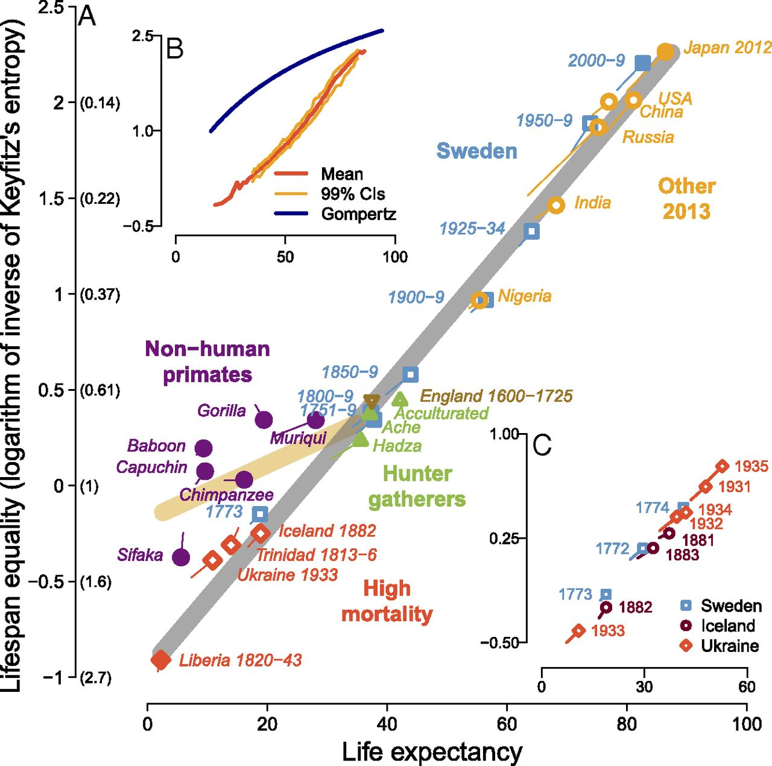
Negative correlation seems to hold over sex, and across different mortality regimes
Colchero et al. (2016) PNAS

Slide 7
Sex differences in life expectancy and disparity
Large differences at low levels of life expectancy
Crossover(s)
Slopes are different in mid-high life expectancies

Slide 8
30 HMD Countries

Slide 9
Coefficient of variation

Slide 10
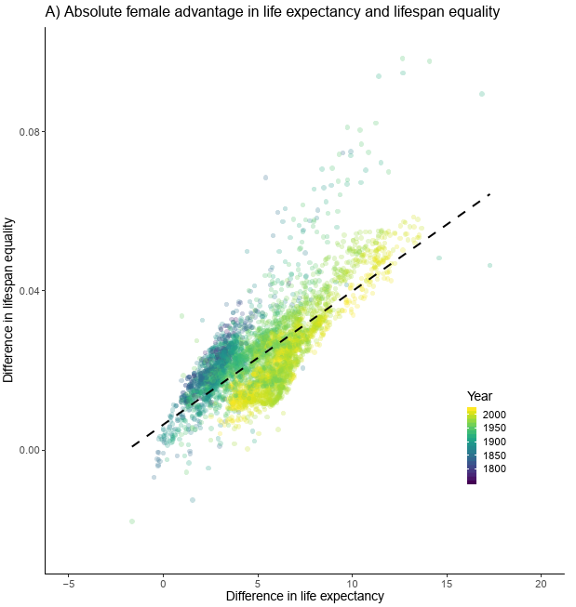
Absolute female advantage in e₀ and lifespan equality

Slide 11
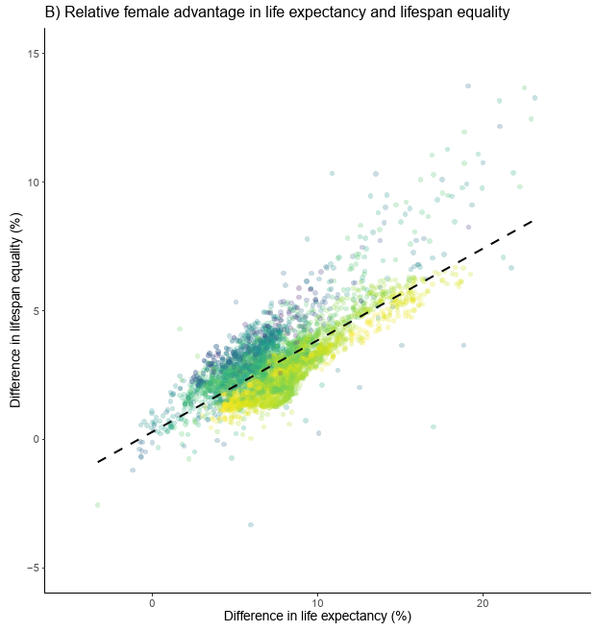
And on a relative scale

Slide 12
Why is this happening?
Do these trends matter?

Slide 13
Hypotheses for the crossover and beyond
Period explains everything
Declining influence of infant mortality
Men always had greater variation in adult mortality
Behavioural differences
Emerging then declining male disadvantage caused by emerging then declining midlife mortality differences
Female survival advantage at old ages
Potential 2nd crossover

Slide 14
Age Decompositions
Before the crossover
During the crossover
Well after the crossover

Slide 15
Comparing mortality patterns before, during, and after crossover
e₀ = 70.3 yrs
Higher ♀ e†
e₀ ~ 73.6 yrs
Same e†
e₀ = 79.3 yrs
Higher ♂ e†
1955
1968
1993
1985
1996
2017

Slide 16
Comparing mortality patterns before, during, and after crossover
♀ e† ~ 14.4
♂ e† ~ 13.4
♀ e† ~ 12.7
♂ e† ~ 12.7
♀ e† ~ 11.1
♂ e† ~ 11.4
e₀ = 70.3 yrs
e₀ ~ 73.6 yrs
e₀ = 79.3 yrs

Slide 17
Comparing mortality patterns before, during, and after crossover
e₀ ~ 70.3 yrs
Higher ♀ e†
e₀ ~ 73.7 yrs
Same e†
e₀ ~ 79.3 yrs
Higher ♂ e†
1955
1968
1993
1985
1996
2017

Slide 18
Decomposition of life expectancy
1955
1968
1993
1985
1996
2017

Slide 19
Decomposition of life disparity
1955
1968
1993
1985
1996
2017

Slide 20


Hypotheses for the crossover and beyond
Period explains everything
Declining influence of infant mortality
Men always had greater variation in adult mortality
Behavioural differences
Emerging then declining male disadvantage caused by emerging then declining midlife mortality differences
Female survival advantage at old ages
Potential 2nd crossover

Slide 21
Summary
Different shape of mortality for men and women
To large extent, already known
But: (1) illustrates the importance of considering the period when thinking about the life expectancy & disparity relationship
(2) Another argument for why we need to monitor variation

Slide 22

Thank you for your attention
vanraalte@demogr.mpg.de
This project has received funding from the European Research Council (ERC) under the European Union’s Horizon 2020 research and innovation programme (grant no. 716323 - LIFEINEQ)

